Slide 1
Coach and Volunteer Recruitment
Notes:
Volunteers are essential for nonprofits. In a sector where we usually have more work to do than we have staff to do it, volunteers boost our power, lighten the load, and exponentially increase our impact. Best of all, they do it because they believe in the cause and want to help.
But how do we find these superstars who freely give their time, energy, and expertise? Where are they all hiding?

Slide 2
ASK
Pitch stories to the media about volunteering, always including that you’re looking for volunteers.
Feature volunteer opportunities in your newsletter, along with a call-to-action to volunteer.
Ask your current volunteers to invite their friends to a volunteer event
In addition to spreading the word, don’t forget to ask one-on-one. You may have supporters who would love to get more involved with your organization, if they only knew you wanted them. Prospective volunteers are everywhere you look.
Notes:
This first point seems obvious, but it’s often overlooked. You need to actually ask people to volunteer. You may think it’s self-evident that you’re looking, but you’d be surprised how many people in your circle don’t know.
Extend the invitation to volunteer across your communication channels:
Do you regularly highlight volunteers and volunteer activities on social media? Do people who see this know they could volunteer, too?
Pitch stories to the media about volunteering, always including that you’re looking for volunteers.
Feature volunteer opportunities in your newsletter, along with a call-to-action to volunteer.
Ask your current volunteers to invite their friends to a volunteer event
In addition to spreading the word, don’t forget to ask one-on-one. You may have supporters who would love to get more involved with your organization, if they only knew you wanted them. Prospective volunteers are everywhere you look.
Once you start looking outside your immediate circle, the Internet is here to help you. Many communities have websites that serve as a central place for posting volunteer opportunities.
There are also national websites that share opportunities or match volunteers and organizations, like VolunteerMatch, Create the Good and Idealist. You can search for volunteer opportunities by location and interests, so it’s a good way to find people in your area who already care about what you do.
Offline, consider partnering with faith organizations and civic groups. You may be able to speak to them about volunteering, or put your ad in their newsletters. Setting up a display and meeting people at volunteer fairs and community events is also a good way to meet new prospective volunteers

Slide 3
Get Specific
“Volunteer” is not a specific description of a job. All it means is that someone isn’t being paid for their time. Therefore, if you put out a general call for volunteers…no one knows exactly what you mean.
Getting specific also helps to get around any mistaken ideas about volunteering that people may have. If someone’s only experience with volunteering is a group or corporate volunteer day, they may think you’re only looking for envelope stuffers or someone to pound nails, which they may or may not be interested in. Specifics paint a clearer picture.
Notes:
Instead of calling for volunteers, ask for people to do the specific jobs you need volunteers for. Put out the call for visitors, for reading buddies, for bike mechanics, for tour guides, for dog walkers, for party planners, or deck builders. Prospective volunteers will know exactly what you’re looking for, and see themselves in your posting.
As well as specific jobs, point to the specific skills that volunteers need to do the job. If you’re willing to teach someone how to do something, make sure you mention it. Otherwise, people may remove themselves from the running if they don’t know how to do the tasks you describe. Likewise, if you need special experience, make that clear.
Getting specific also helps to get around any mistaken ideas about volunteering that people may have. If someone’s only experience with volunteering is a group or corporate volunteer day, they may think you’re only looking for envelope stuffers or someone to pound nails, which they may or may not be interested in. Specifics paint a clearer picture.
make sure the volunteers know we need them for the "job" they have volunteered for, it's a commitment to the agency and most importantly the athletes. So many volunteers think they can come and go as they please.

Slide 4
Focus on Their Benefits, Not Your Needs
Notes:
We’ve established that volunteers are wonderful and you need them. Now it’s time to flip the question, and ask why they need you. Why should someone give their time to your organization?
easy to focus on your organizational needs, but this cannot be the central story of your volunteer recruitment efforts. “We need help!” may be true, but it doesn’t make the most compelling case for volunteering. Instead, focus on what volunteers gain by giving their time. Things like:
Making a difference
Using their skills and talents for good
Meeting others in the community
Working for a cause they believe in
Helping others
Example– “Ditch your winter blues for winter boots as a SOWI volunteer!” This call for volunteers focuses on making a difference, getting outside, and having fun, all benefits to prospective volunteers.

Slide 5
Easy and Nice
Notes:
Have you tried to sign up to volunteer for your organization? Is it easy? Are there clear steps to take? Are the people you encounter friendly and helpful?
It’s worth it to make sure you aren’t offending or otherwise giving prospective volunteers a negative experience before they even get to you. Don’t underestimate the power of a form that won’t load, a cold-sounding receptionist, or an unreturned phone call to turn a volunteer off your organization forever. It sounds dramatic, but it really does happen.
Take a look at the Red Cross of Chicago and Northern Illinois’ website. It clearly lays out next steps toward becoming a volunteer, and provides an email address and phone number, along with a great big “Apply to Volunteer” button. It’s easy to navigate, which means people are much more likely to actually begin and complete the process.

Slide 6
Notes:
When someone expresses an interest in volunteering with you, follow up quickly, even if it’s just to say, “Thanks, we’ll get back to you soon.” You want them to know how much you value their interest, so don’t leave them hanging.

Slide 7
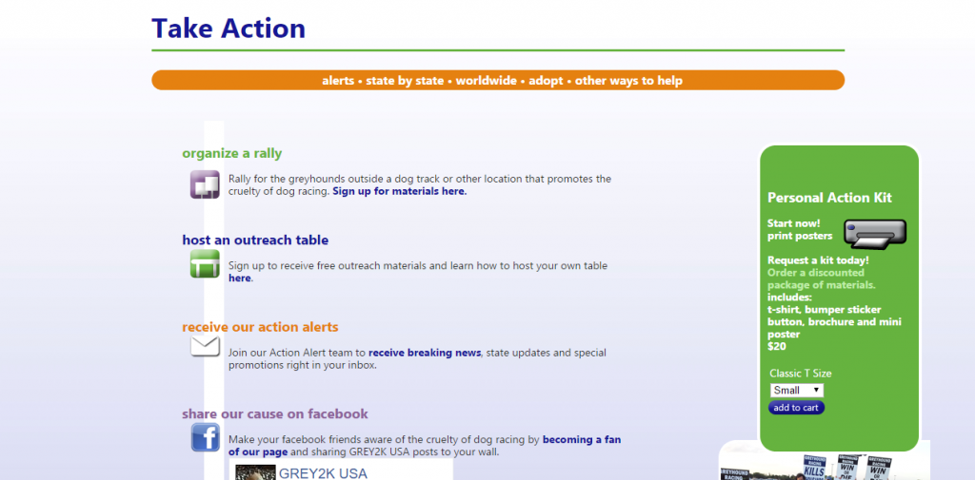
Provide Opportunities for Different Levels of Engagement
Notes:
Some volunteers will be ready to take on a part-time job level of volunteering, while others will be looking for something to do once a month, or a couple times a year. Maximize the number of volunteers you can appeal to by providing opportunities to help out at different levels of commitment.
Grey2K, a national organization dedicated to ending greyhound racing, gives several options for ways to get involved. Some, like organizing a rally, are a large undertaking. Others, like hosting an outreach table, are less of a commitment. They even give the option of sharing posts on social media–a very low commitment, but still a big help.
Make it clear in your volunteer content that you have opportunities for different levels of commitment. This helps people understand that they can be as involved as they want to be. If someone has a positive experience doing a small volunteer assignment for your organization, they may consider getting more involved in the future.
So Remember…
Ask people to volunteer, within your circles, and the larger community.
Be specific about what you’re looking for
Focus on the benefits to volunteers, rather than to your organization
Double-check to make sure it’s easy and pleasant to sign up to volunteer
Provide a range of volunteer opportunities to engage volunteers at different levels of commitment.

Slide 8
Agency Needs
• Coach • Assistant Coach • Chaperone • Agency Management Team Members • Games Management Team Member • Agency Manager • Unified Sports® Partner
• Competition day of event • Official • Scorekeeper/Timer • Awards Presenter • Athlete Escort • Special Event Help
Notes:
Volunteering with Special Olympics Wisconsin
Special Olympics Wisconsin would not exist today and could not have been created without the time, energy, and dedication of thousands of volunteers. Our success is driven by the dedication of our thousands of event volunteers, agency managers, and coaches. If you are seeking a volunteer opportunity that can make a difference in your life and the lives of others, we need you! There is no experience required; however, you must be at least 15 years of age, unless accompanied by an adult.

Slide 9
Recruitment Is Just The First Step
Once you’ve recruited a new volunteer, you’ve only just begun! Now you’ll need to manage and retain them. Retainment is the opposite side of the recruitment coin, and it might even be more important.
Welcome your new volunteers, and make sure someone is appointed to check in and engage with them regularly, so that the volunteers you worked so hard to recruit grow with your organization.

Slide 10
Thank you for all you do!

