Slide 1

Local Program Finance Meeting
Hosted by Field Services and SOWI Operations
Mark Wolfgram, Robin Van Fleet Bergan, Theresa Rossman, and Kaylor Wiedenbeck

Slide 2
Welcome & Introduction

Slide 3
Discussion Topics
Invoice Approval Form
W9
Expense Reimbursement Form
Petty Cash Request Form
Pre-Event Notification Form
Local Program Deposit Ticket
Sales Tax
Raffles
Notes:
The key topics for tonight are the Invoice Approval Form, W9, Expense Reimbursement Form, Petty Cash Request Form, Pre-Event Notification Form, Local Program Deposit Ticket, Sales Tax and Raffles. We will offer a few breaks in the presentation to allow for questions.

Slide 4
Important Reminder – Class A
Local Program Managers and Treasurers must be Class A Volunteers
  Application
  Protective Behaviors Course
  Background Check
  Due every three years
    If your name is not on the Volunteer Look-Up on the SOWI website, at least one part of the Class A process is missing.
      Please reach out to Kaylor Wiedenbeck for assistance in completing the Class A process.
Notes:
Before we begin reviewing the paperwork and procedures for finance management, we wanted to highlight a very important reminder – local program managers and treasurers must be Class A volunteers. Additionally, people handling cash at fundraising and sporting events must also be Class A. The Class A application, Protective Behaviors course, and background check through Sterling Volunteers are due every three years. These steps are outlined on our website. If you are reviewing your volunteer roster on the website and someone is not appearing who you believe is Class A, please reach out to me (Kaylor Wiedenbeck). I can advise which step or steps are necessary for Class A renewal.

Slide 5
Making Purchases
Before placing an order, please submit our Sales Tax Exemption Certificate to the vendor to have sales tax removed from the order.
  Use our 15-digit number: 008-0000134473-06
  Online orders through Amazon or in-person sales at Wal-Mart, as examples, will not accept the form and tax will be due.
After making a purchase, submit an Invoice Approval Form or Volunteer Expense Reimbursement Form to Accounts Payable.
Notes:
As a reminder, we are exempt from paying sales tax. A copy of our Sales Tax Certificate is saved on the Tools and Resources page of our website. When placing an order, for example for uniforms, please provide the vendor with this sales tax exemption certificate to have sales tax removed from the order. When an online order is placed on Amazon or a purchase as made at Wal-Mart, as examples, the tax exemption form will not be accepted and tax must be paid.
After a purchase is made, submit an Invoice Approval Form or Expense Reimbursement Form must be submitted to AP along with corresponding documentation.
The key difference between these forms is that Invoice Approval Forms should be for invoices we pay to a third-party vendor based on their invoice. The Volunteer Expense Reimbursement Form should be used when a Class A volunteer makes a purchase on behalf of the local program and needs to be reimbursed.

Slide 6
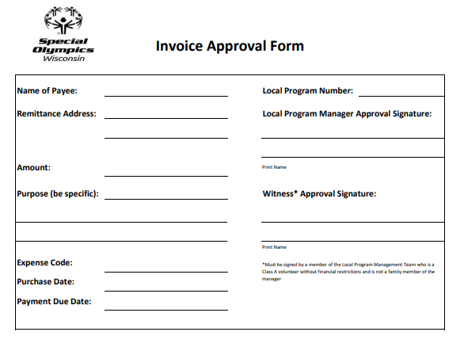
Invoice Approval Form – Part 1
Notes:
We have made a few adjustments to the Invoice Approval Form. This updated form has been saved on the Tools and Resources page of our website. We added a new field of remittance address to ensure checks are mailed to the correct location. The other fields remain the same:
Name of Payee – Who the check should be made out to / Amount – Amount due / Purpose – Notes regarding the purchase / Expense Code – I will explain further on the next slide
Purchase Date – The date the order was placed /Payment Due Date – When an invoice from a vendor has a due date, please use that date. If it is for a reimbursement or there is no due date listed, you can leave this blank or note “Next Check Run.” / Local Program Number – Please reference which local program placed the order / Agency Manager and Witness Approval Signatures & Names – These individuals must be Class A and members of the Local Program Management Team
Please ensure all fields on the form are completed and all corresponding documentation is included before submitting to AP to prevent payment delays.

Slide 7
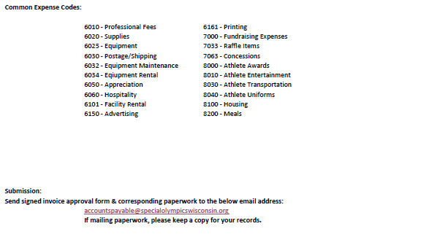
Invoice Approval Form – Part 2
Notes:
At the bottom of the Invoice Approval form, we have included a list of common expense codes. If you are unsure of which account code to use, please contact us.
At the end of the Invoice Approval form, we have included the Accounts Payable email address where the completed form and corresponding documentation can be sent.
E-mail is the preferred method of communication due to mailing delays and ensuring each party has a copy of paperwork.
If you prefer to mail the paperwork, please keep a copy of all documentation for your records. In case the first copy is lost, we need to have a back-up to process payment.

Slide 8
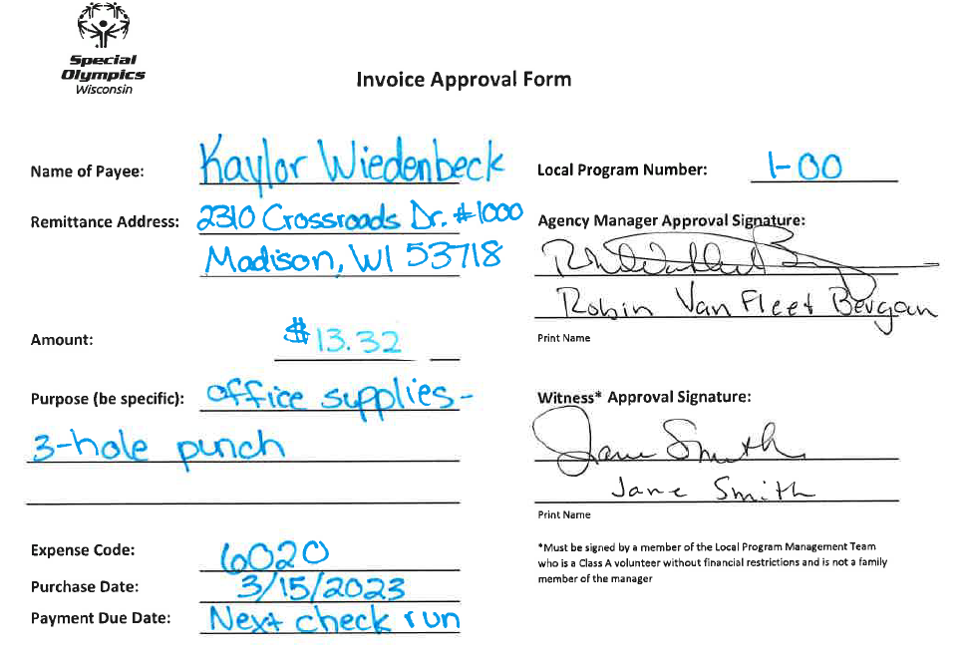
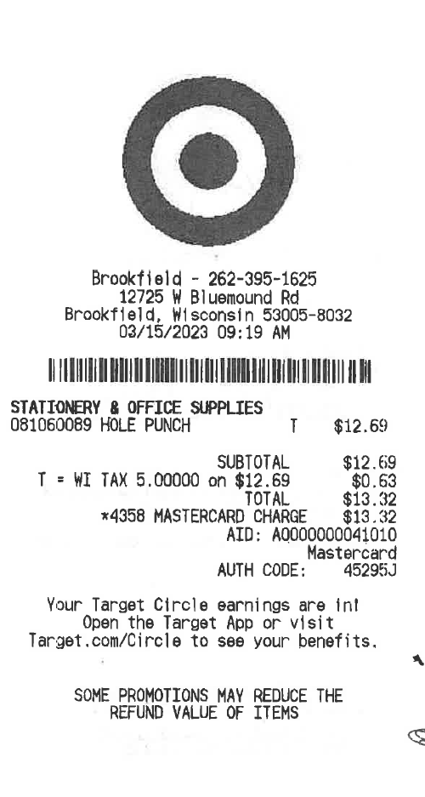
Invoice Approval Form Example
Notes:
Here is an example of a completed Invoice Approval Form. We will assume I am the vendor on this transaction that should be paid – all fields are filled out and it is signed by the Local Program Manager and another member of the Local Program Management Team.

Slide 9
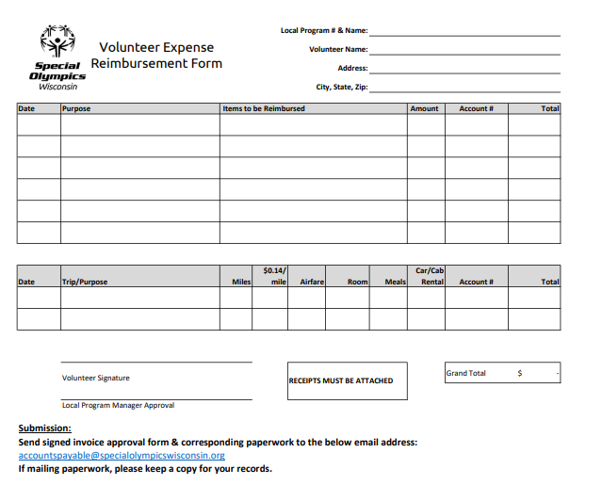
Volunteer Expense Reimbursement Form
Notes:
This is the Volunteer Expense Reimbursement Form. This should be completed when a volunteer has made a purchase that should be reimbursed from the local program’s account. An example of this would be a basketball purchased online at Amazon by a coach – the Amazon order confirmation would serve as a receipt or back-up.

Slide 10
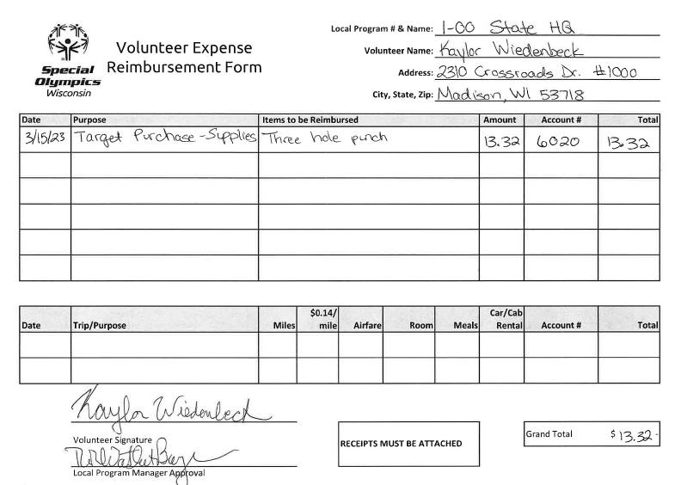
Expense Reimbursement Form - Example
Notes:
Here is an example of a completed Volunteer Expense Reimbursement form and the corresponding receipt, using the same receipt as earlier. Please ensure all fields on the form are completed and all corresponding documentation is included before submitting to AP to prevent payment delays.
Currently, we are receiving invoice approval forms and expense reimbursement forms for volunteer reimbursements. We will continue to accept both for situations where volunteers need to be reimbursed for items already purchased. Please use whichever form you prefer.

Slide 11
AP Form Submissions
Invoice approval forms/volunteer expense reimbursement forms must be e-mailed (or mailed) within a week of purchase
Payments will be mailed within 10-14 business days from the date a completed invoice approval form is received
Include a W-9 for new vendors (example to follow)
Notes:
Please forward invoice approval forms and documentation as soon as possible – within a week after the date of purchase. This will allow us to record expenses in the proper period as well as stay current with our vendors.
We will review, process, and submit payment for the completed invoice approval forms within 10-14 business days.
If we have any questions on the invoice approval form, we will contact you by phone and/or email. Please ensure we have your up-to-date contact information and notify us of any changes. You can review our current information on the Volunteer Lookup search on our website.
For new vendors, please include a W-9 with your invoice approval form.

Slide 12
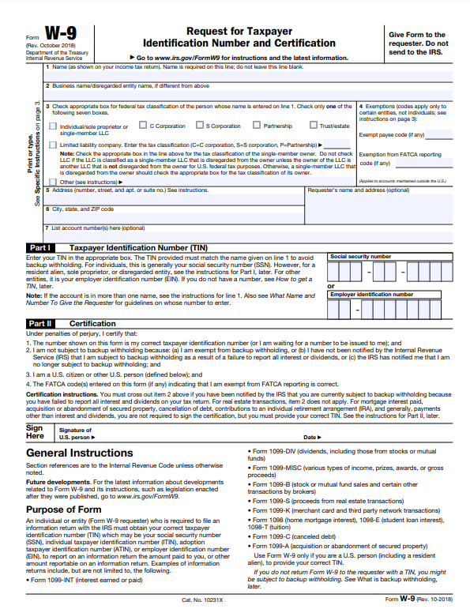
W9 Example
Minimum information needed:
  Name
  Business Type
  Address
  EIN/SSN
  Signature and Date
Notes:
Here is a copy of a W-9 form for your reference. The minimum information we need completed on the W9 are the vendor’s name, business type, address, Employer Identification Number or Social Security Number, a signature and date. Most vendors have completed forms ready to send customers. We need these forms for tax reporting. There is usual a dollar amount threshold of $600, however whenever we use a new vendor, we ask that a W9 is completed. For example, 2 local programs could use a vendor for 2 $300 orders, so together they would reach that threshold. It’s always better to have the paperwork to be on the safe side.

Slide 13
AP Questions?

Slide 14
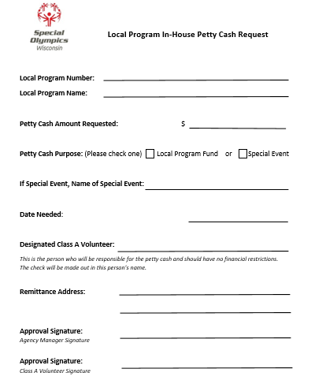
Petty Cash Request Form
Notes:
A revised Petty Cash Request form has been added to the website.

Slide 15
Petty Cash Request Form – When to Use
Requests up to $250
Use for incidentals: office supplies, stamps
Turn in receipts and reconciliations at least once per quarter
May request additional Petty Cash for event attendance
Turn in receipts and excess funds the week following the event

Slide 16
Pre-Event Notification Form-Part 1

Slide 17
Pre-Event Notification Form-Part 2

Slide 18
Local Program Deposit Ticket

Slide 19
Sales Tax
SOWI is a tax-exempt organization, but we are not exempt from collecting sales tax
Purchases made by local programs are exempt from sales tax
Subject to Sales Tax
  Registration, Admission, Participation fees
  Suggested prices
  Auction items
  Fundraising vary by item sold
  Re-sale of items
  Special Olympics staff will make the final determination on sales tax

Slide 20
Questions?

Slide 21

Raffle – Class A
Notify Operations Department and request license
Ticket Requirements
  Pre-Printed Tickets with consecutive numbers
  Name & Address of licensed organization – State office address
  Raffle license
  Prizes over $1000
  Date and location of drawing
  Collect W9 for ALL cash prizes and items valued over $600
  No price discounts
Raffle Reporting Form – complete and submit to State office
Retain stubs 1 year after drawing

Slide 22

Raffle – Class B
Notify Operations Department and request license
Tickets must be the same color, shape and size
Collect W9 for ALL cash prizes and items valued over $600
Raffle Reporting Form – to be completed

Slide 23
Raffle Reporting Form

Slide 24
Raffle Questions?

Slide 25
Forms Saved on SOWI Website
Under Tools & Resources, Local Program Information:
  Invoice Approval Form
  Expense Reimbursement Form
  Sales Tax Exemption Certificate
  Petty Cash Request Form
  Pre-Event Notification Form
  Local Program Deposit Form
  Raffle Reporting Form
https://www.specialolympicswisconsin.org/agency-management-portal/tools-resources/

Slide 26
Contact Information
For questions regarding Accounts Payable or payment status, please contact: accountspayable@specialolympicswisconsin.org or 608-442-5665.
For questions regarding cash receipts, please contact:
trossman@specialolympicswisconsin.org or 608-442-5664.
For questions regarding raffles, please contact: rvanfleetbergan@specialolympicswisconsin.org or 608-442-5684.

Slide 27
Questions?

